Slide 1
Predictive Modeling for Disease Diagnosis presentation

Slide 2
Current Challenges
Objective
Develop a predictive model to classify individuals as diseased or non-diseased.
Healthcare professionals usually rely on diagnostic tests which their data intake could be inaccurate and could have marginal loss that can give an incorrect data that can affect their results.

Slide 3
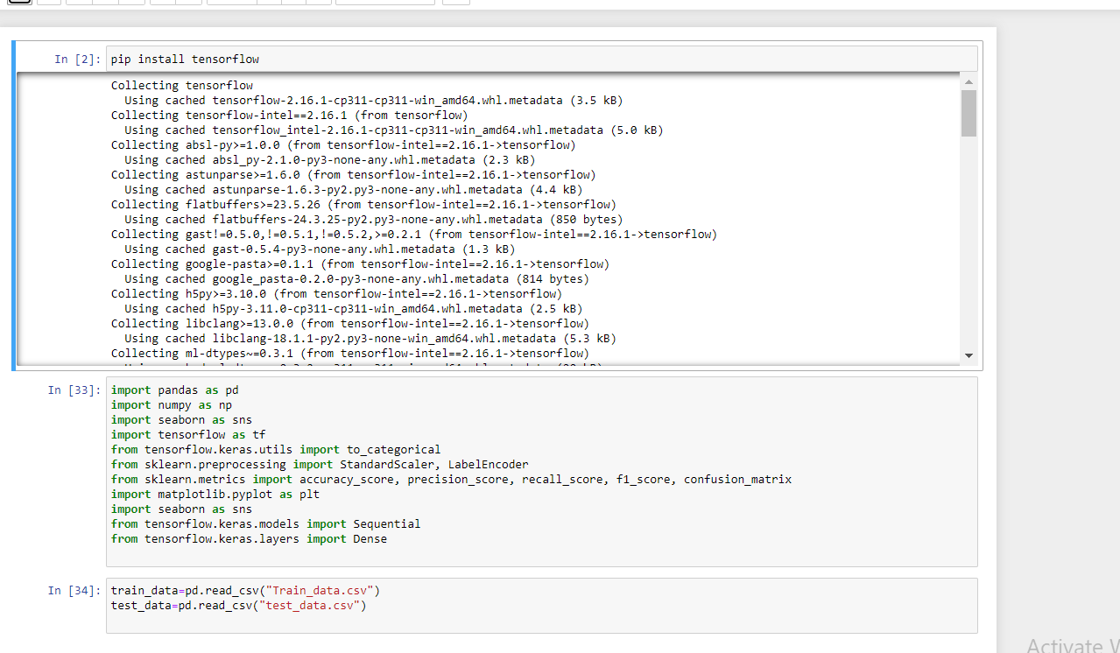
THE FIRST STEP
Adding Libraries to start our model and calling it by inserting our provided dataset.

Slide 4
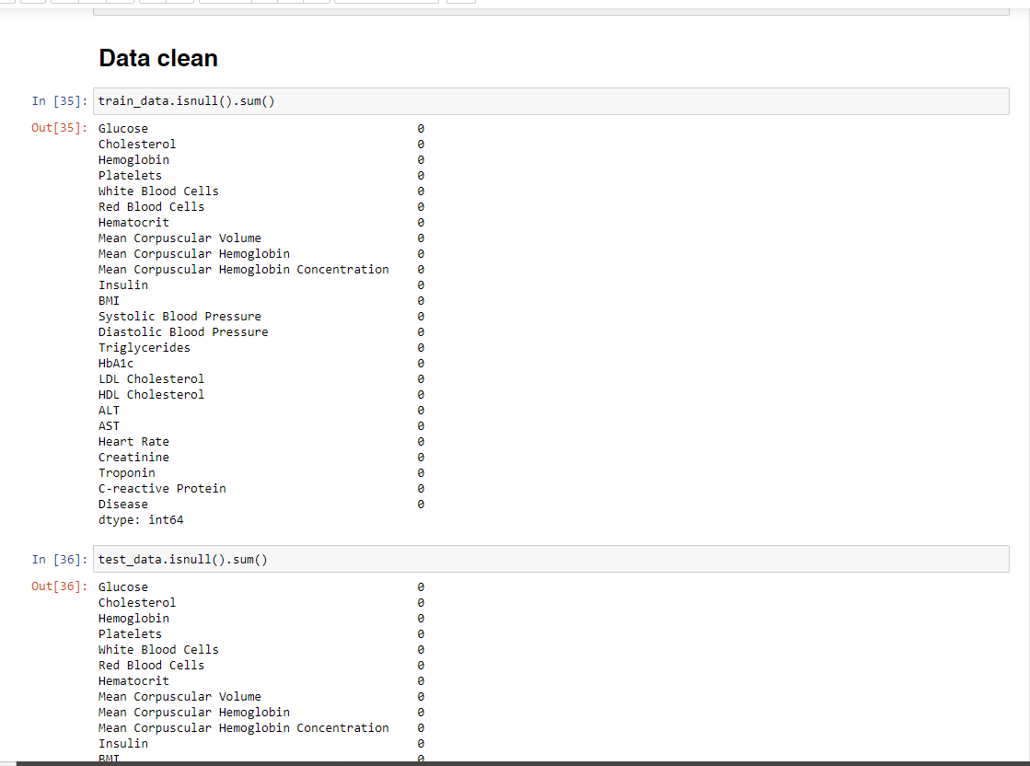
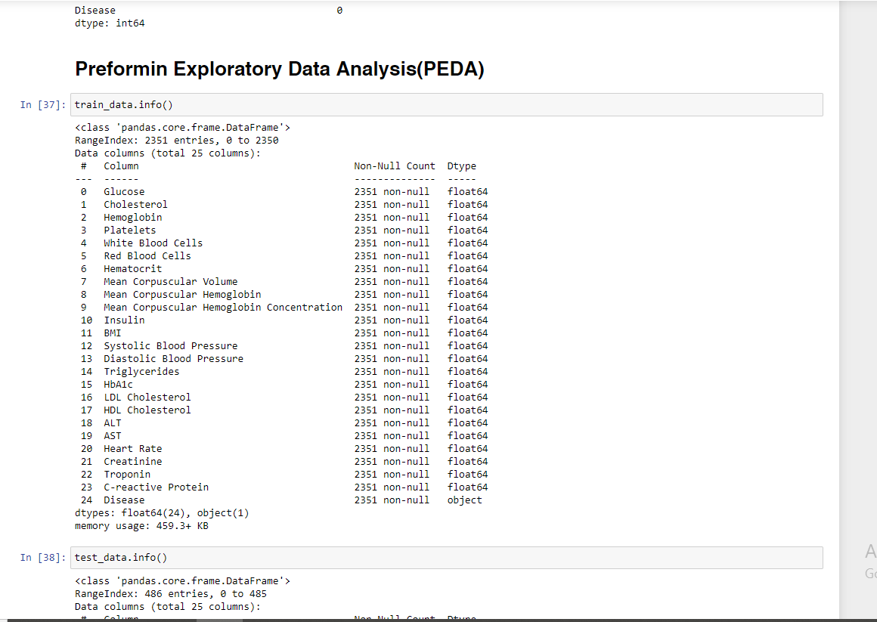
Second step
Here we continue with data cleaning and analysis

Slide 5
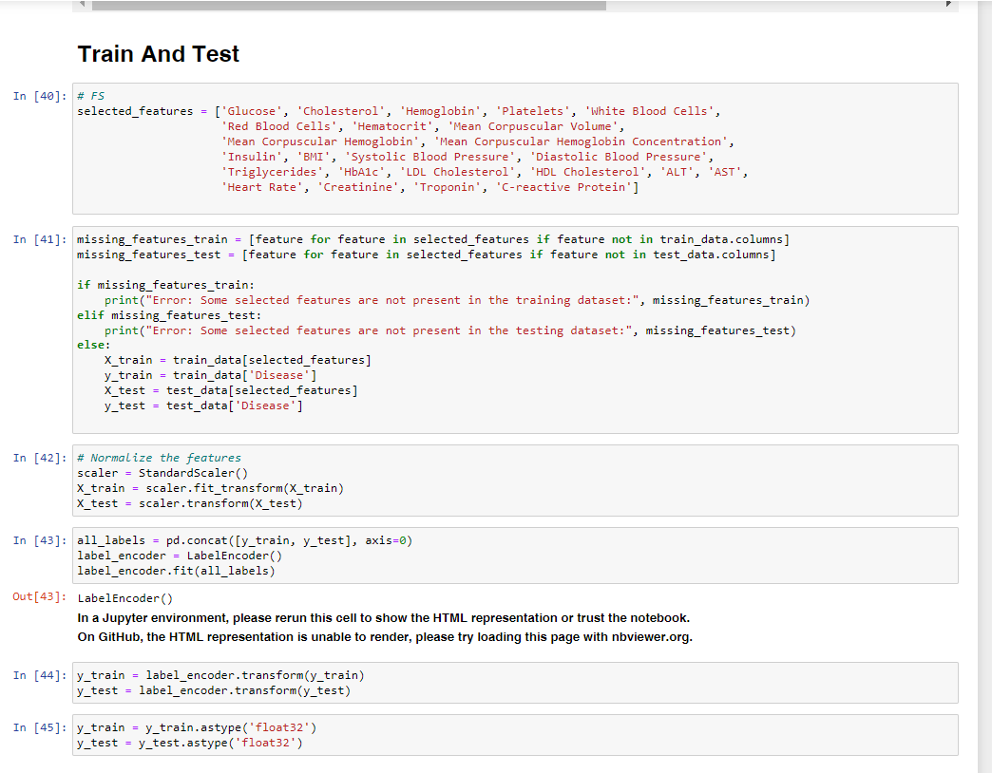
third step
Training and Testing the data is mandatory in order for our model to work efficiently.

Slide 6
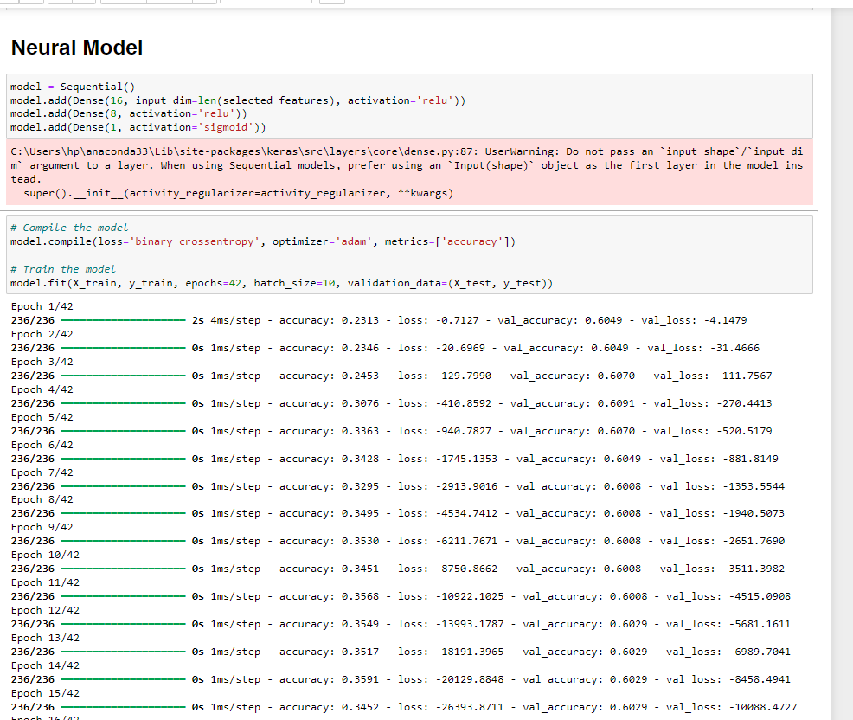
Fourth step
In the following step we used the Neural Model
due to it being the best suited for our dataset since it gives the best performance and very efficient during its results

Slide 7
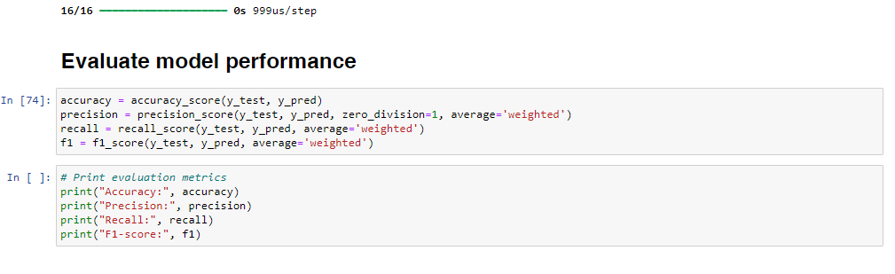
Fifth step
This is our evaluation code, the provided the best possible outcome due to the Neural Model

Slide 8
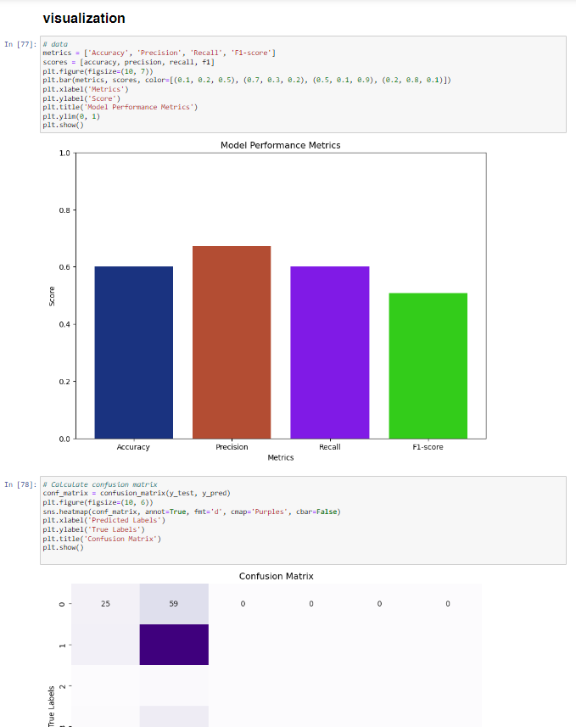
Last step
The visualization step was not required but I provided a representation of our outcome performance where accuracy and others predicted was shown with the dataset representation seperately.

Slide 9
Thank you
Ahmed Mohamed Tawab
+201020750220
ahmedtawab017#@gmail.com

